Slide 1

Hands-on practice
Dr. Wei Ma
Genome Curation Scientist
Hong Kong Genome Institute
13th Oct 2023

Slide 2
Exonic splicing variant
Presentation title
Department name

Slide 3
Clinical Details
One frameshift variant in COX20 in trans with
NM_198076.6(COX20):c.41A>G p.(Lys14Arg)
Clinical features
Chronic axonal neuropathy
Gross motor delay with progressive deterioration since childhood
Progressive motor weakness and loss of walking ability
Mild cognitive impairment
Pathology testing
Nerve/muscle biopsy:
chronic axonal neuropathy
neurogenic muscle atrophy
Chr1: 244,835,755 (GRCh38)
Rs ID : rs1057521790
Located in exon 1 of 4
gnomAD (v.2.1.1)= 1 in 41838
gnomAD (v.3.1.2)= 7 in 148900
How should we classify this exonic COX20 variant?

Slide 4
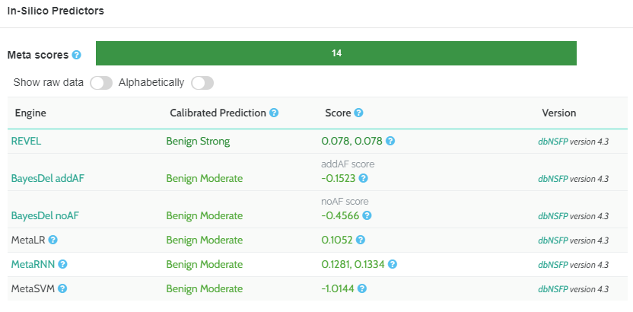
Multiple in silico prediction tools predict the missense variant to be benign

Slide 5
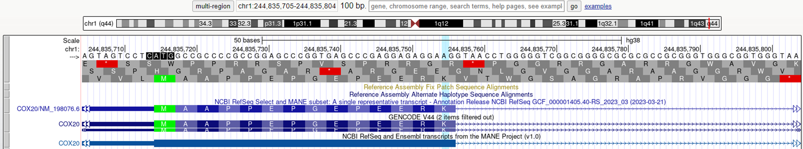
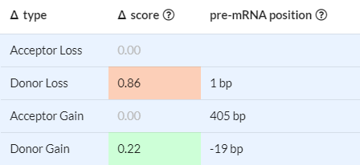
Further analysis reveals the variant locates near exon junction
∆
Prediction tools (MaxEntScan and SpliceAI) both predicts the variant to cause loss of splice donor
→ Search literature for functional evidence

Slide 6
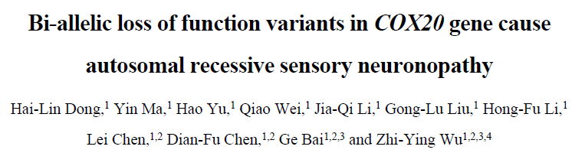
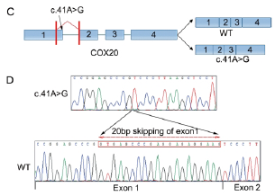
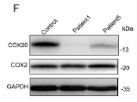
c.41A>G causes 20bp skipping of exon 1 and result in frameshifting of COX20 in multiple unrelated patients
results in p.(Gly8ValfsTer2) and is predicted to undergo NMD
reduced COX20 protein
PVS1 (RNA)
Overall classification of c.41A>G :
Pathogenic
PVS1 (RNA), PM3, PP4, PM2_Supporting
Patient1: homozygous c.41A>G
Patient5: heterozygous c.41A>G + 1 p.W74C
Bi-allelic loss of function variants in COX20 gene cause autosomal recessive sensory neuronopathy. Brain. 2021. PMID: 33751098
6

Slide 7
Variant case study

Slide 8
Case 1
Patient with on set of muscular dystrophy since childhood
CRPPA NM_001101426.4:c.1251G>A in trans with another nonsense variant

Slide 9
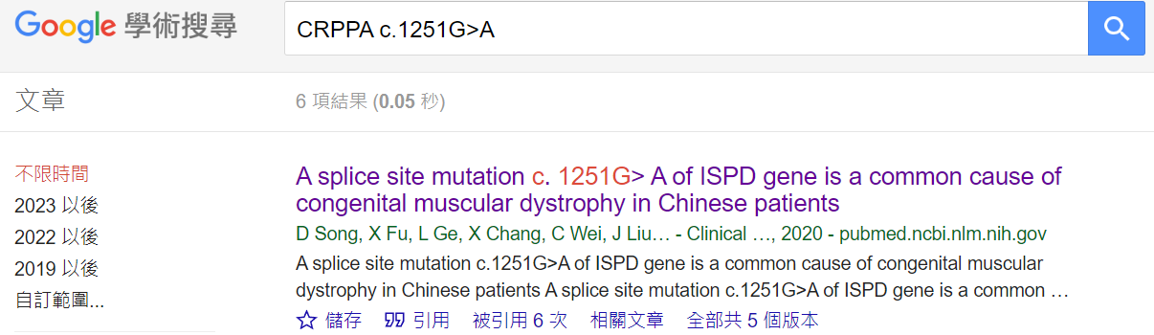
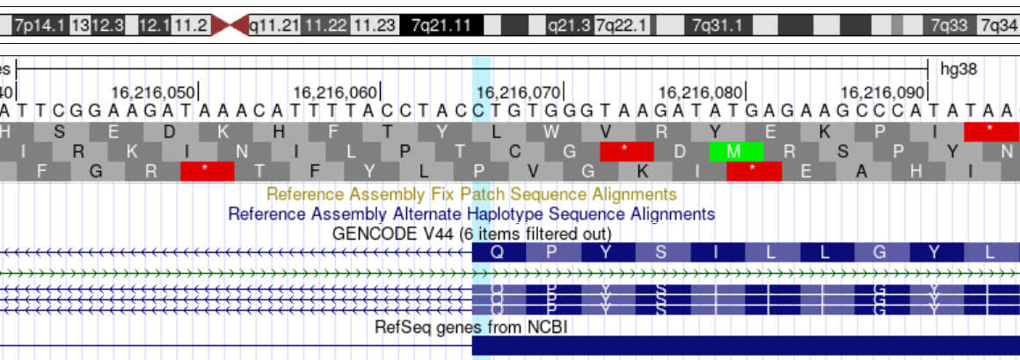
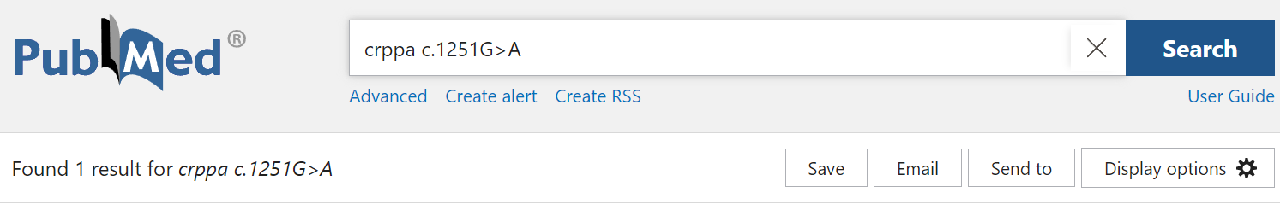

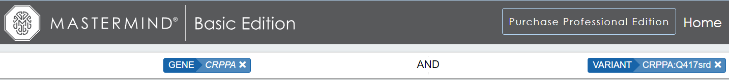
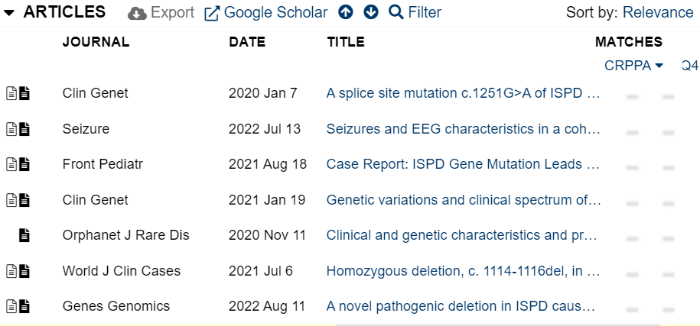
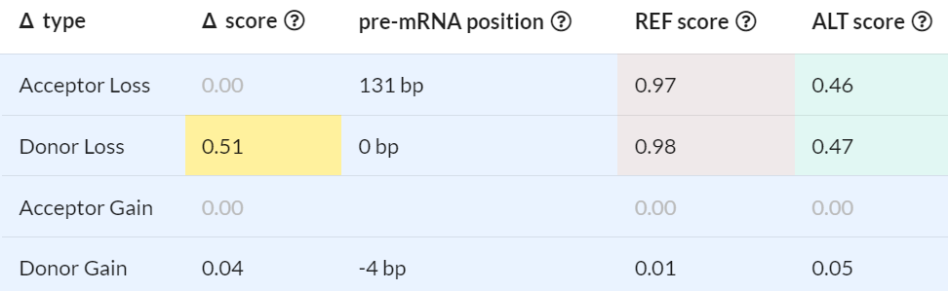
Materials for classification
Affected amino acid? → A synonymous variant
NM_001101426.4:c.1251G>A p.(Gln417=)
Search results
∆
SpliceAI
Notes:
Splice regions: “srd” and “sra”
chr7-16216066
16216197
132
Q417-V374

Slide 10
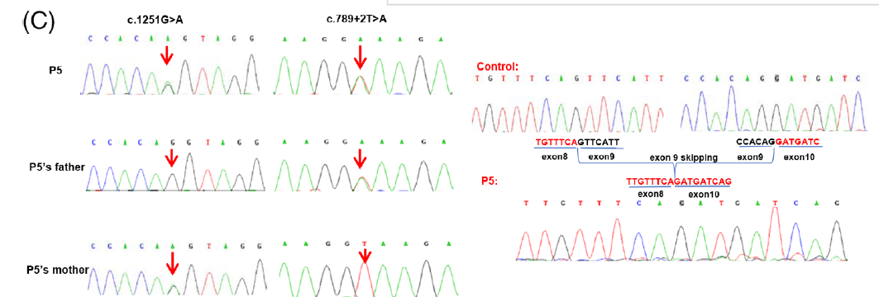
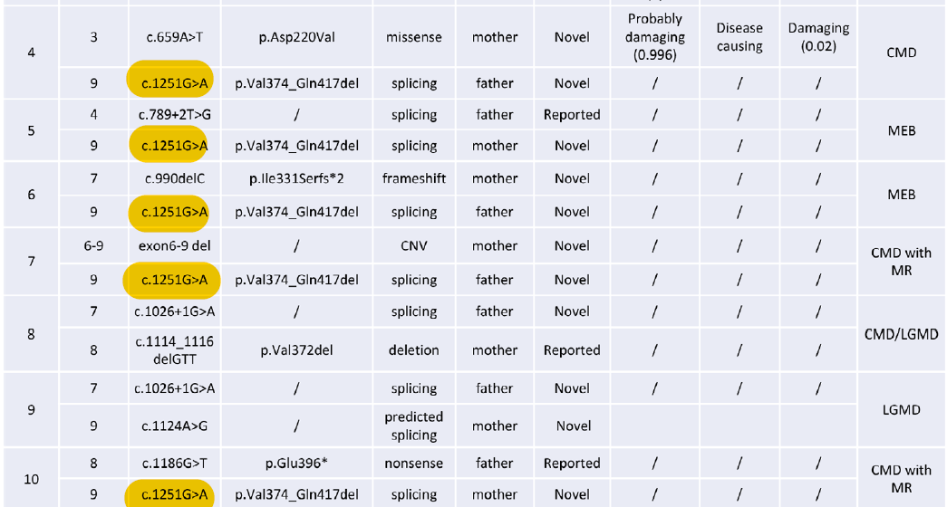
exon 9 of CRPPA
132bp
encodes V374-Q417
PVS1_Moderate(RNA)
PM3_VeryStrong
Song et al. Clin Genet. 2020

Slide 11
Suggested classification
Pathogenic
PM3_VeryStrong
PVS1_Moderate(RNA)
PM2_Supporting

Slide 12
Case 2
Patient clinically diagnosed with Duchenne Muscular Dystrophy with negative DMD IHC staining in muscle biopsy
DMD NM_004006.3:c.3603G>T

Slide 13
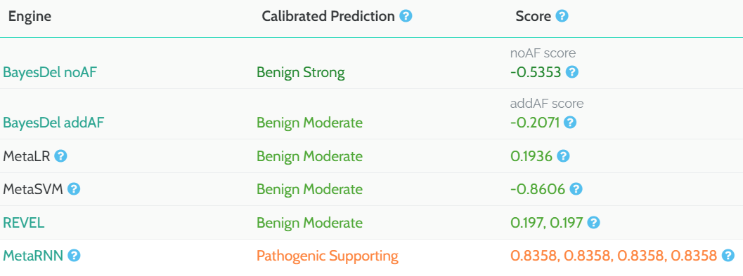
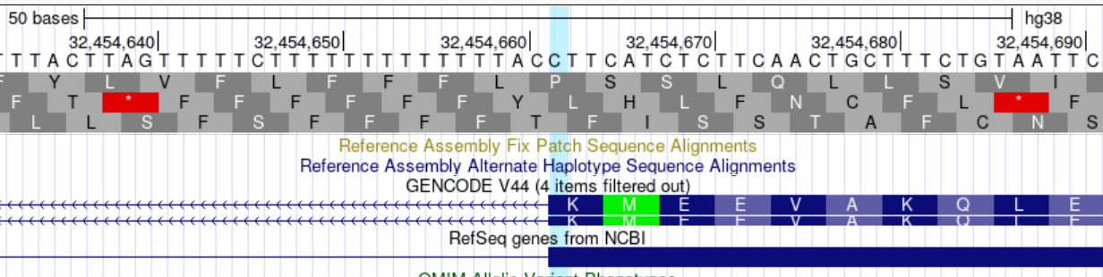

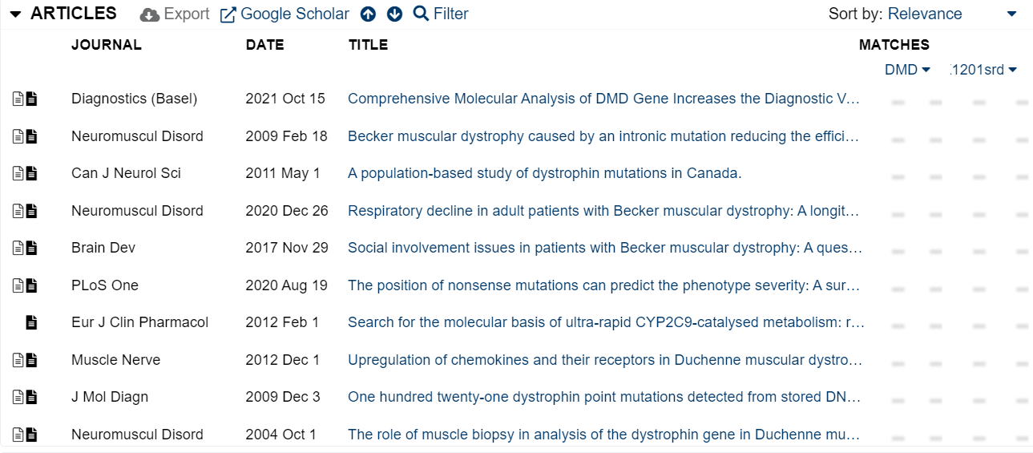
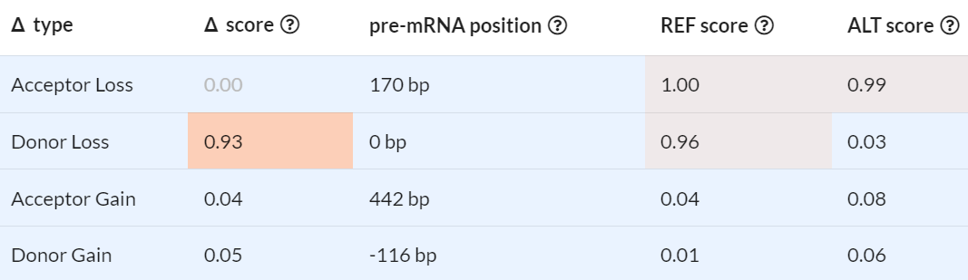
Materials for classification
Affected amino acid? → p.(Lys1201Asn) NM_004006.3(DMD):c.3603G>T p.(Lys1201Asn)
Variant in exon 26
Exon 26 = 171 bp
∆
SpliceAI
Notes:
Splice regions: “srd” and “sra”
32454662
32454832

Slide 14
Suggested classification
VUS
PP3
PM2_Supporting
PP4
Potential upgrade
Sequencing parental samples to test for de novo occurrence
Muscle biopsy for RNA-seq to confirm splicing effect

Slide 15
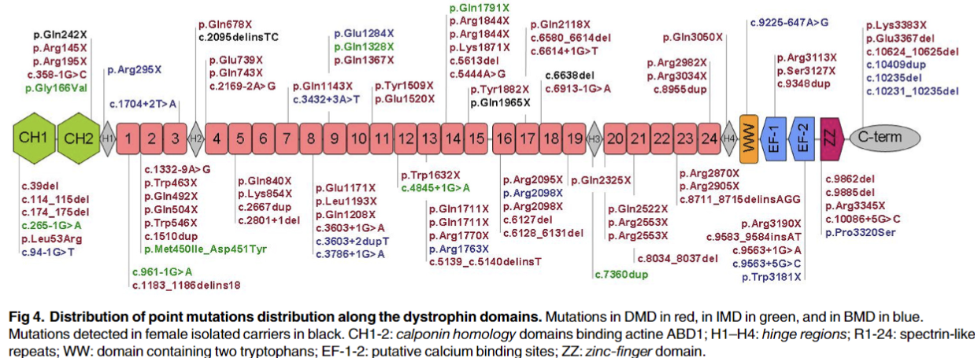
Variant is Located in the Rod Domain of DMD
Dystrophin contains a 24-repeat units of rod domain (spectrin-like domain).
c.3603G>T p.(Lys1201Asn) is located in its 8th repeat.
The function of this domain is not well established.
It is expected to account for the flexible structure of protein.
Variants are observed throughout the gene in Duchenne muscular dystrophy patients.
p.(Lys1201Asn)
Blake D.J. et al, Function and Genetics of Dystrophin and Dystrophin-Related Proteins in Muscle, Physiol Rev, 2002, 82:291-329
Juan-Mateu J. et al, DMD Mutations in 576 Dystrophinopathy Families: A Step Forward in Genotype-Phenotype Correlations, PLoS ONE, 2015, 10
Notes:
rod domain 7-8 affected

